Slide 1
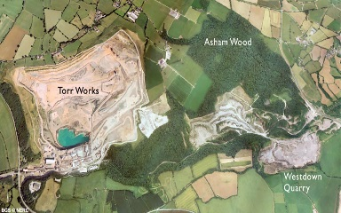
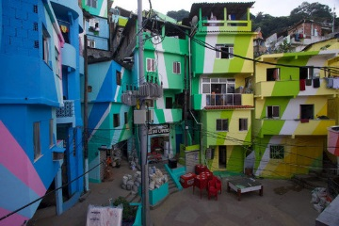
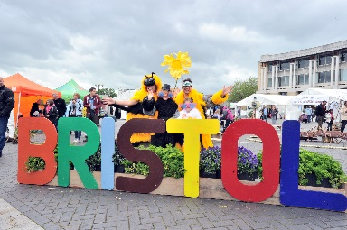
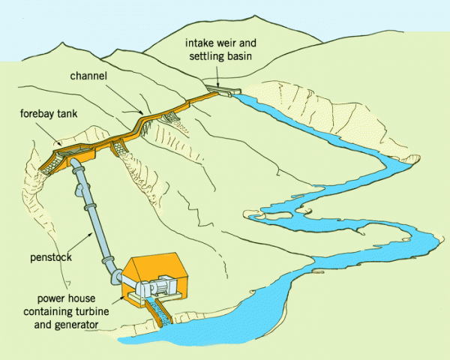
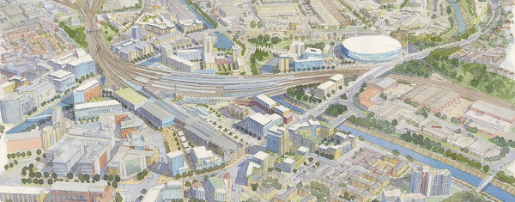
GCSE Geography Paper 2
One Last Time…
Section A:
Urban issues and challenges (Rio and Bristol)
Urban planning to improve quality of life for the urban poor (Favela Bairro)
Urban regeneration project in the UK (Temple Quarter, Bristol)
Urban sustainability and Urban Transport Strategies
Section B:
Development, causes and consequences of uneven development.
Strategies to reduce development gap & Tourism in Jamaica
Economical development in Nigeria
Economic change in the UK
Section C:
Resource Management
Energy
Example of gas extraction

Slide 2
Urban Issues and Challenges
The global pattern of urban change and urban trends in different parts of the world – urbanisation is slower in HICs than LICs because most area than can be urbanised are urbanised and the birth rate is slower than LICs. LICs urbanise due to improved economic development, industry and trade that HICs have already had/got. In the majority of HICs over 60% of the country’s population live in urban areas. Urbanisation is increasing in places such as India, China and Nigeria.
Causes of urbanisation – migration (push and pull factors) and natural increase.
Megacities – cities with over 10 000000 people living in them, often found towards the coast. Tokyo, Lagos and New York.

Slide 3
Urban Issues and Challenges (Rio de Janeiro) LIC/‘NEE’
Location and importance – Brazil’s Atlantic coast at 23⁰S and 43⁰W. It has grown around a large natural bay called Guanabara Bay. Until 1960, Rio was the capital of Brazil, the capital is now Brasilia. Rio is an NEE. Brazil’s GPD is 1.796 trillion.
Regional (local) importance – hospitals, schools and employment.
National (Brazil) importance – second largest city in Brazil, construction companies, 5% to Brazil’s GDP. In 2013, Rio accounted for 12% of Brazil’s GDP.
International (global) importance – tourism - statue of Christ (one of the seven new wonders of the world), world cup 2014, Olympics 2016. Trade of food, clothing and furniture.

Slide 4
Urban Issues and Challenges (Rio de Janeiro) LIC/‘NEE’
Causes of urban growth – migration (from China to set up trade, from surrounding countries and the Amazon Basin for jobs, education and healthcare) and natural increase (1.78 births per woman). The north zone is poor, west zone is wealthy.
How urban growth has created opportunities –
social:
access to services – health (Santa Maria – medics visited homes to detect and treat diseases) and education (99% literacy rate).
access to resources – water supply (95% of the population had mains water supply by 2014), energy (60km of new power lines installed).
economic:
how urban industrial areas can be a stimulus for economic development/trade/jobs (Rio is second most important city in Brazil, Rio provides 6% of Brazil’s employment, it has one of the highest incomes per person in Brazil, types of employment include oil, retail, steel, tourism and construction). b

Slide 5
Urban Issues and Challenges (Rio de Janeiro) LIC/‘NEE’
How urban growth has created challenges:
managing urban growth – slums, squatter settlements
providing clean water and sanitation systems (Guanabara bay is very polluted, 200 tonnes of raw sewage and 50 tonnes of industrial waste pumped into the Bay daily) and energy (frequent blackouts due to people illegally tapping into supplies)
providing access to services – health (in 2013, only 55% of the city had access to family health clinics) and education (in Rio only half of all children continue their education past 14 years old).
reducing unemployment (recession in 2015, over 20% unemployment rate in favelas) and crime (robbery, drugs and violent crime).

Slide 6
Urban Issues and Challenges (Rio de Janeiro) LIC/‘NEE’
managing environmental issues –
waste disposal (favelas are very mountainous – steep relief and narrow roads stop trucks from being able to collect the rubbish, most is dumped in water and causes waterborne diseases such as cholera),
air pollution (causes 5000 deaths per year in Rio from heavy traffic giving off fumes and smog) and
water pollution (many of the 55 rivers flowing into Guanabara Bay are polluted),
traffic congestion (car ownership in Rio has increased by over 40%, high crime means people prefer to travel by car, tunnels need building in the hills to increase accessibility).

Slide 7
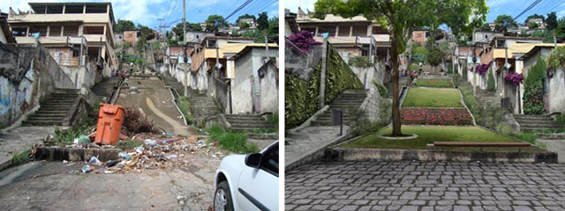
Urban Issues and Challenges (Favela Bairro Project, Rio, North Zone)
An example of how urban planning is improving the quality of life for the urban poor.
The Favela Bairro Project is a government plan to improve and upgrade the quality of life in the favelas rather than adopt a policy of demolition of the favelas. Upgrading involves providing people with:
Materials and skills to improve their houses
Roads
Electricity, water and sanitation
The Favela Bairro Project is a ‘site and service’ scheme provided by the local authority which includes:
Rehousing people in new basic housing.
Developing new areas of the city where people can be rehoused.
Enforcing evictions in some favelas to allow for development.
Introducing self-help schemes to redevelop housing.
Providing programs for youths to stop getting into crime.

Slide 8
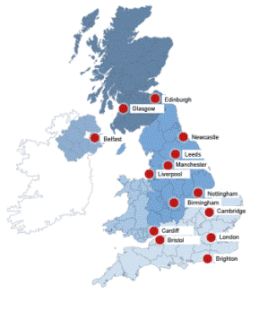
Urban Issues and Challenges Urbanisation in the UK
Overview of the distribution of population and the major cities in the UK – more people live in lowland areas (east, south and south-east of the UK) in cities such as London as these are easier to urbanise. Less population in high-land areas such as Scotland and Wales as these are harder to urbanise due to the relief. Industrial cities tend to be in the North.

Slide 9
Urban Issues and Challenges (UK – Bristol)
A case study of a major city in the UK to illustrate:
• the location (Bristol is the largest city in the south west of England. It has a population of 440 500) and importance of the city in the UK and the wider world (Industry – largest concentration of silicon chip manufacture outside California, Education; 2 universities, tourism; the UK’s 8th most popular city for foreign visitors).
• impacts of national and international migration on the growth and character of the city (population doubled between 1851 and 1891, fifty countries are represented in Bristol’s population, main is Poland, then Somalia – new festivals, new cuisine, new businesses such as international grocery shops and restaurants, ethnic enclaves and new religions, young migrants balance out the ageing population).

Slide 10
Urban Issues and Challenges (UK – Bristol)
how urban change has created opportunities:
social and economic:
cultural mix (Bristol’s youth population means there is a vibrant underground music scene in addition to nightclubs and bars, new festivals such as the Chinese new year and ‘Little Polish Festival in 2018),
recreation and entertainment (Bristol has 2 pro soccer teams; City and Rovers and a rugby union team – their stadiums provide a range of leisure and conference opportunities; Cabot circus is a shopping district with leisure facilities taking up to 2/3 of space and it has a cinema and 250 apartments),
employment (increased number of people working in high-tech companies. There are 50 microelectronic and silicon design businesses in Bristol, employment rate of around 76%),
integrated transport systems (park and ride: The Rapid Transit Network consists of three bus routes from Temple Meads train station, Bristol plans to develop an integrated transport system linking different forms of public transport within the city. The aim is to get people to travel using public transport instead of cars – reducing congestion and air pollution).
environmental:
urban greening (1/3 of Bristol is open space and more than 90% of people live within 350km of parkland and waterways. Bristol has 8 nature reserves and 300 parks. Queen Square was once a dual carriage way but is now transformed into a cycle way with open space. Green initiatives include: 30% of city to be covered in trees.)

Slide 11
Urban Issues and Challenges (UK – Bristol)
how urban change has created challenges:
social and economic:
urban deprivation (Filwood (south of Bristol) is in the top 10 % of the most socially deprived areas in the country)
inequalities in housing (Housing in Filwood is split equally between owner occupied and those rented from the city council. Compared to Stoke Bishop in the north of Bristol where 81% of the housing is owner occupied. Most of the council houses in Filwood were built in the 1930s and are poorly insulated).
Education (In Filwood in 2013 only 36% of students got top grades at GCSE, including English and Maths compared to 94% in Stoke Bishop (wealthier area)
health (– In Filwood death rates from cancer are higher than average and life expectancy is 78 years compared to 83 years in Stoke Bishop)
employment (Only 3% of people in Stoke Bishop are unemployed compared to 1/3 of people aged 16-24 in Filwood)

Slide 12
Urban Issues and Challenges (UK – Bristol)
how urban change has created challenges:
environmental:
Dereliction (Stokes Croft in Bristol’s inner city became notorious for its derelict housing and abandoned properties and many empty houses have been taken over by squatters and the area has suffered from anti-social behavior)
building on brownfield and greenfield sites, (brownfield sites need bulldozing and decontaminated and greenfield sites leads to a reduction in the urban-rural fringe)
waste disposal (The city produces half a million tonnes of waste per year. It is among the worst cities in the country in terms of the amount of food waste it creates)

Slide 13
Urban Issues and Challenges (UK – Bristol)
how urban change has created challenges:
the impact of urban sprawl on the rural–urban fringe, (Large housing estates have been built on rural greenfield land. This provides a pleasant environment for people to live in but means that open spaces are lost and ecosystems damaged or destroyed. Out of town developments take advantage of cheaper land outside the city and easily accessible to lots of people. Large areas of rural land are lost and it can lead to air and noise pollution as well as traffic congestion).
and the growth of commuter settlements (Commuter settlements are places in the rural-urban fringe where the majority of the population leaves the town each day to work elsewhere.
This can cause challenges:
New housing developments can affect the character of rural settlements and damage the environment.
Demand for housing increases house prices. Locals may not be able to afford to stay)

Slide 14
Urban Issues and Challenges UK Regeneration Project – Temple Quarter in Bristol)
An example of an urban regeneration project to show:
• reasons why the area needed regeneration
During the late twentieth century, decline set in. Industries closed, and land became derelict, run-down and polluted. By the 1990s much of the area comprised unused railway lines, demolished slum housing and abandoned wasteland. It was very run-down.
• the main features of the project.
The 70-hectare Temple Quarter project was officially opened in 2012 and is expected to last for 25 years.
The target is to create 4 000 new jobs by 2020 and 17 000 jobs by 2037. By 2015, 300 businesses had already been attracted to the area creating over 2 000 jobs.
Land has been cleared and decontaminated.
New offices, houses and retail areas will be constructed, and the area will be landscaped, with green areas, footpaths and cycleways.

Slide 15
Urban Issues and Challenges
Features of sustainable urban living:
• water (recycling rainwater, half flush toilets) and energy conservation (renewable energy – solar panels and wind turbines, insulating walls and double glazing window).
• waste recycling (recycle plants, separate bins for different items, fortnightly collection to encourage recycling).
• creating green space (parks, trees, green roofs).
How urban transport strategies are used to reduce traffic congestion.
(congestion charge, trams, park and ride, cycle schemes, more frequent public transport)

Slide 16
Changing Economic World
Different ways of classifying parts of the world according to their level of economic development and quality of life - (LIC/NEE/HIC).
Different economic and social measures of development: - gross national income (GNI) per head, birth and death rates, infant mortality, life expectancy, people per doctor, literacy rates, access to safe water, Human Development Index (HDI).
Limitations of economic and social measures – data could be out of date, data may be unreliable due to government corruption and they focus on certain aspects of development and may not take into account a holistic view.

Slide 17
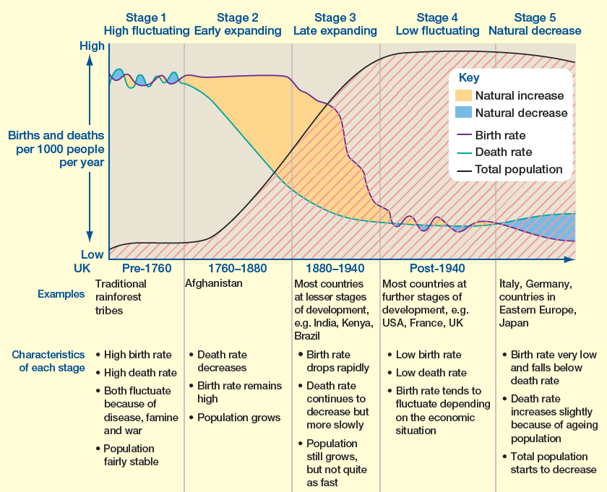
Changing Economic World
Link between stages of the Demographic Transition Model and the level of development.
HICs (stage 4 and 5)
LICs (stage 1 and 2)
NEEs (stage 2 and 3)

Slide 18
Changing Economic World
Causes of uneven development:
Physical (landlocked, climate, location/topography, clean water)
economic (trade)
Historical (colonisation, civil war)
Consequences of uneven development:
disparities in wealth (Africa’s share of global wealth is very small (about 1 per cent)
health (in LICs 4 in every 10 deaths are among children under 15 years, and only 2 in every 10 deaths among people aged 70 years and over. In LICs death often results from waterborne disease and starvation whereas in HICs it’s lung cancer and other cancers),
international migration (emigrants leave a place usually because of war or lack of opportunity – often the working ages in LICs and NEEs. Economic migrants move to HICs, open new businesses or work and pay taxes)

Slide 19
Changing Economic World
An overview of the strategies used to reduce the development gap:
investment,
industrial development
tourism,
aid,
using intermediate technology,
fairtrade,
debt relief,
microfinance loans.

Slide 20
Changing Economic World
An example of how the growth of tourism in an LIC or NEE helps to reduce the development gap.
How has Tourism helped to reduce the Development Gap?
In 2014, tourism contributed 24% towards Jamaica’s GDP (this is expected to rise to 30% by 2024).
Tourism income exceeds $2 billion each year.
Tourism is the main source of employment – over 200 000 locals are employed in hotels, shops and agriculture.
Increased incomes have improved the retail sector and increased the amount of money circulating the economy.
Infrastructure has been improved to support tourism (new ports, roads and hotels).
Many local people in the key tourist sites of Montego Bat and Ocho Rios have experienced improvements in their quality of life, though there are still some pockets of poverty.
The environment has benefited by landscaping projects (Montego Bay and the designation of nature parks like Negril Marine Nature Park).

Slide 21
Changing Economic World
A case study of one LIC or NEE to illustrate:
the location
Nigeria is located in north-west Africa. Bordering countries include Benin, Chad, Niger and Cameroon. It is on the Atlantic Coast. It is almost due south of the UK.
importance of the country,
regionally
Nigeria has one of the fastest growing economies in Africa. In 2014 it had the highest GDP in the continent and the third largest manufacturing sector • It is the most populated country in Africa – with a population of 182 million • Nigeria has the highest farm output in Africa – 70% of the population are employed in agriculture.
and globally
In 2014 Nigeria became the world’s 21st largest economy. • Nigeria had the world’s highest average GDP growth for 2010-15 • Nigeria supplies 2.7% of the world’s oil • Nigeria has also developed a very diverse economy which now includes financial services, telecommunications and the media.

Slide 22
Changing Economic World
The context of Nigeria
Politically - Nigeria became independent from the UK in 1960. However bitter power struggles resulted in a series of dictatorships and a civil war between 1967 and 1970. Lack of political stability affected Nigeria’s development and led to widespread corruption. It is only since 1999 that the country has a had a stable government.
Socially - Nigeria is a multi-ethnic, multi faith country. Ethnic groups in Nigeria include the Yoruba (21%) Hausa and the Fulani (29%) and Igbo (18%). Christianity and Islam are practiced widely. This social diversity is one of Nigeria’s great strength but is also causes conflict. Economic inequality between the north and south of Nigeria has created new religious and ethnic tensions, with the rise of the Islamic Fundamentalist group Boko Haram – this has created an unstable situation in Nigeria and has had a negative impact on the economy, with a reduction in investment from abroad.
Cultural - With such a diverse population Nigeria enjoys a rich and varied culture: • Nigerian music is enjoyed across the continent e.g. Fela Kuti • Nigerian cinema (known as Nollywood is the second largest film industry in the world • In sport, the Nigerian football team has won the African Cup of Nations three times, most recently in 2013.
Environmental - Nigeria’s natural environments form a series of bands across the country. This reflects the decreasing rainfall from north to south. To the north of Nigeria is the Sahel and the Sahara. • Savanna can be found in the upland region of Jos Plateau (central Nigeria) • In Southern Nigeria – high temperatures and high annual rainfall (similar to rainforest climate).

Slide 23
Changing Economic World
the changing industrial structure. The balance between different sectors of the economy.
Since 1999 there have been major changes in Nigeria’s industrial structure: Employment in agriculture has fallen from 70% to 33% in 2012 – this is because farm machinery is used more and because of better pay and conditions in other sectors of the economy • Industrialisation and economic growth (secondary sector) under a stable government has increased employment in oil production, manufacturing of products such as construction, motor manufacturing and sugar refining. The % of people employed in manufacturing has increased from 20% in 1999 to 33% in 2012 • The growth of the tertiary sector – communications, retail and finance. This has increased from 10% to 33%. These changes mean that Nigeria now has a balanced economy – an even balance between the different sectors.

Slide 24
Changing Economic World
How manufacturing industry can stimulate economic development
Regular paid work gives people a more secure income and provides a larger home market for purchasing products such as cars and electrical appliances • As industries grow more people are employed, and revenue from taxes increases • A thriving industrial sector attracts foreign investment which stimulates further economic growth

Slide 25
Changing Economic World
the role of transnational corporations (TNCs) in relation to industrial development. Advantages and disadvantages of TNC(s) to the host country

Slide 26
Changing Economic World
international aid: types of aid, impacts of aid on the receiving country
Nigeria receives about 4% of aid given to African countries. In 2013 aid represented 0.5% of Nigeria’s GNI – nearly US$5000 million. Most came from individual countries such as the UK and USA, and some from international organisations such as the World Bank. Charities and NGOs have also supported aid projects in Nigeria.
Examples of aid include; Aid from the USA helps to educate people and protect people against the spread of HIV and AIDS, The NGO Nets for Life provides education on Malaria prevention and distributes anti-mosquito nets to households and in 2014 the World Bank approved US$500 million to fund development projects and provide long term loans to businesses.
What prevents aid from being used effectively? – Corruption by the government and by individuals is a major factor in the loss of aid and donors may have political influence over what happens to the aid

Slide 27
Changing Economic World
the environmental impacts of economic development
Nigeria has done this through activities like farming, oil extraction and manufacturing things in factories.
While it’s great that Nigeria has done so well, their rapid economic development has created negative environmental impacts:
In Lagos many harmful pollutants go directly into open drains and water channels – these are harmful to people and damage ecosystems downstream
70-80% of Nigeria’s forests have been destroyed through logging, urban expansion and industrial development. Many species have disappeared e.g. cheetahs and giraffes and 500 species of plant.
Many oil spills in the Niger Delta have had disastrous impacts on freshwater and marine ecosystems – Bodo oil spills (2008)

Slide 28
Changing Economic World
the effects of economic development on quality of life for the population.
Quality of life is commonly measured using the UNs HDI. Nigeria’s HDI has been increasing steadily from 2005. It has risen from 0.465 in 2005 to 0.505 in 2013. Life expectancy has risen from 46 in 1990 to 52 to in 2013 Mobile phone subscriptions from 0 in 1990 to 73 in 2013 Mortality rates have decreased from 213/1000 in 1990 to 117/1000 in 2013 Despite these clear improvements many people are still poor, Limited access to services such as safe water and sanitation is still a problem e.g. % of people with access to sanitation facilities dropped from 37% in 1990 to 28% in 2013.

Slide 29
Changing Economic World UK Changing Economic Futures
Economic futures in the UK:
• causes of economic change: de-industrialisation and decline of traditional industrial base, globalisation and government policies
• moving towards a post-industrial economy: development of information technology, service industries, finance, research, science and business parks

Slide 30
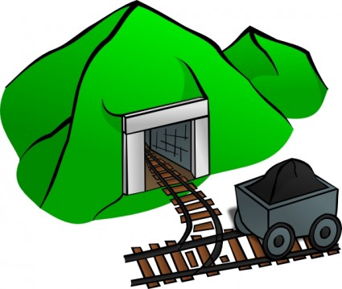
Changing Economic World UK Changing Economic Futures Torr Quarry, Somerset
impacts of industry on the physical environment (visual pollution, air and water pollution, transport of goods leads to CO2 emissions).
An example of how modern industrial development can be more environmentally sustainable
How is Torr Quarry environmentally sustainable?
The quarry is being restored to create wildlife lakes for recreation and water supply.
Characteristic limestone features will be created to make the landscape look natural.
200 acres of the site have already been landscaped to blend in with the surrounding countryside, including planting grass and trees.
Regular monitoring of noise, vibration, airborne emissions (dust) and water quality.
Rail transport minimises the impact on local roads and villages.

Slide 31
Changing Economic World UK Changing Economic Futures
social and economic changes in the rural landscape in
one area of population growth – South Cambridgeshire (reduction in agriculture employment, lack of affordable housing, 80% UK car ownership is leading to traffic in rural areas, young people move away so left with ageing population)
and one area of population decline – The Outer Hebrides, Scotland (number of schoolchildren is expected to fall, less working age people, ageing population, main industry is sheep farming, in 2014, there was a 27% in tourism)

Slide 32
Changing Economic World UK Changing Economic Futures
improvements and new developments in
road (100 new road schemes by 2020, 1300 new lanes added to motorways)
rail infrastructure (electrification of the trans-pennine express railway between Manchester and York by 2020, HS2 high-speed 2 – a £50mn plan to connect London with Birmingham, then Sheffiled, Leeds and Manchester),
port (Liverpool 2 – more space for shipping containers)
airport capacity (a new runway at heathrow (cost £18.6bn), constructing a new runway at Gatwick)

Slide 33
Changing Economic World UK Changing Economic Futures
the north–south divide (in general the south enjoys more prosperity and a better quality of life than the north of the UK).
Strategies used in an attempt to resolve regional differences
Enterprise Zones
Local enterprise partnerships
Science parks in the north
Planned transport improvement (HS2 London to Manchester)
In 2015, the UK launched the northern powerhouse concept – encouraging industrial and infrastructural developments in northern England.

Slide 34
Changing Economic World UK Changing Economic Futures
the place of the UK in the wider world. At its peak, the British empire covered around 1/3 of the world’s land areas with colonies in Africa, Asian Pacific and Americas. In the 20th century many former colonies got independence and the UK became a member of the commonwealth. It is a global transport and financial centre.
Links through trade, culture, transport, and electronic communication. The UK trades with many countries by sea, air, road and rail (channel tunnel), UKs major trading partners are the EU.
Economic and political links: the European Union (EU) and Commonwealth. At current, in the EU, goods, services, capital and labour can move freely between countries in the EU often called the ‘free market’. Many people of British decent now live in commonwealth countries such as Canada, Australia and New Zealand. Commonwealth games is one of the world’s major sporting events.

Slide 35
Resource Management
The significance of
food (men – 2500 calories a day, women – 2000 calories a day),
Water (in the UK, about 75% of water is used in industry, 22% for domestic purposes and 3% in agriculture)
energy (use of fossil fuels for industry, households and transport) to economic and social well-being.
An overview of global inequalities in the supply and consumption of resources. (Food surplus in much of Europe, Asia and North and South America, in Africa however there is a food deficit. Africa and parts of the middle east is prone to water shortages and drought. Many poor countries experience energy insecurity).

Slide 36
Resource Management
An overview of resources in relation to the UK.
Food: (40% of food in the UK is imported)
• the growing demand for high-value food exports from low income countries and all-year demand for seasonal food and organic produce
• larger carbon footprints due to the increasing number of ‘food miles’ travelled, and moves towards local sourcing of food (food produce around 17% of UK carbon emissions – 11% due to the transport of imported food).
• the trend towards agribusiness (intensive farming, some government grants – helps produce more food).

Slide 37
Resource Management
An overview of resources in relation to the UK.
Water: (amount of water used in households has risen by 70% since 1985).
• the changing demand for water (population increase, industrial production, baths/showers and wealth)
• water quality and pollution management (chemicals, fertilisers and pesticides, increased legislation in the UK limits the amount of waste that can be input in rivers).
• matching supply and demand – areas of deficit and surplus (north and west experience water surplus, south and east experience water deficit)
• the need for transfer to maintain supplies.

Slide 38
Resource Management
An overview of resources in relation to the UK.
Energy:
• the changing energy mix – reliance on fossil fuels, growing significance of renewables (31% coal, 19% nuclear, 25% gas, 22% renewable)
• reduced domestic supplies of coal, gas and oil
• economic and environmental issues associated with exploitation of energy sources.

Slide 39
Resource Management Energy
Areas of surplus (security) and deficit (insecurity):
• global distribution of energy consumption and supply
• reasons for increasing energy consumption: economic development, rising population, technology
• factors affecting energy supply: physical factors, cost of exploitation and production, technology and political factors.

Slide 40
Resource Management
Impacts of energy insecurity – exploration of difficult and environmentally sensitive areas, economic and environmental costs, food production, industrial output, potential for conflict where demand exceeds supply.

Slide 41
Resource Management
Overview of strategies to increase energy supply:
• renewable (biomass, wind, hydro, tidal, geothermal, wave and solar) and non-renewable (fossil fuels and nuclear power) sources of energy

Slide 42
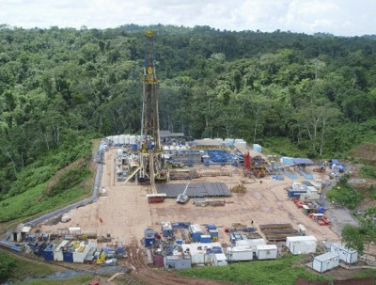
Resource Management Camisea project, Peru – Extraction of Natural Gas
an example to show how the extraction of a fossil fuel has both advantages and disadvantages.
Advantages
Could save Peru up to $4 billion US dollars in energy costs.
Peru could make several billion dollars in gas exports – up to $34 billion over the 30-year life of the project.
Provides employment opportunities and helps boost local economies.
Improved infrastructure could bring benefits to local people. Agriculture could become more productive.
Disadvantages
Deforestation due to construction of pipelines and other developments will destroy natural habitats.
Local people have no immunity to diseases introduced into the area by developers.
The project could impact on the lives of several tribes, affecting their traditional way of life and their food and water supplies.
Clearing routes for pipelines has led to landslides and pollution of streams resulting in the decline of fish stock.

Slide 43
Resource Management
Moving towards a sustainable resource future:
• individual energy use and carbon footprints.
Energy conservation: designing homes, workplaces and transport for sustainability, demand reduction, use of technology to increase efficiency in the use of fossil fuels

Slide 44
Resource Management The Chambamontera Micro-Hydro Scheme, Andes Mountains, Peru
an example of a local renewable energy scheme in an LIC or NEE to provide sustainable supplies of energy
The Scheme
The solution to Chambamontera’s energy deficit involved the construction of a micro-hydro scheme supported by the charity Practical Action. The high rainfall, steep slopes and fast flowing rivers make this area ideal for exploiting water power as a renewable source of energy. The total cost of the scheme was $51 000 US dollars. There was some government money and investment from Japan, but the community had to pay part of the cost. The average cost per family was $750 US dollars. Credit facilities were made available to pay for this.
Need for the Scheme
Most people in the area are dependent on subsistence farming with some small-scale coffee growing and rearing of livestock. Development has been badly restricted by a lack of electricity for heat, light and power. Despite farming being efficient, nearly half the population survive on just $2 US dollars a day.
The steep slopes rise to 1700 kilometres and the rough roads are impassable in winter. This makes Chambamontera a very isolated community. Due to the low population density it was uneconomic to build an electricity grid to serve the area.

Slide 45
Resource Management The Chambamontera Micro-Hydro Scheme, Andes Mountains, Peru
an example of a local renewable energy scheme in an LIC or NEE to provide sustainable supplies of energy
How has the scheme benefitted the local community?
Provides renewable energy
Has little environmental impact
Has low maintenance and running cost
Used local labour and materials

